Slide 2
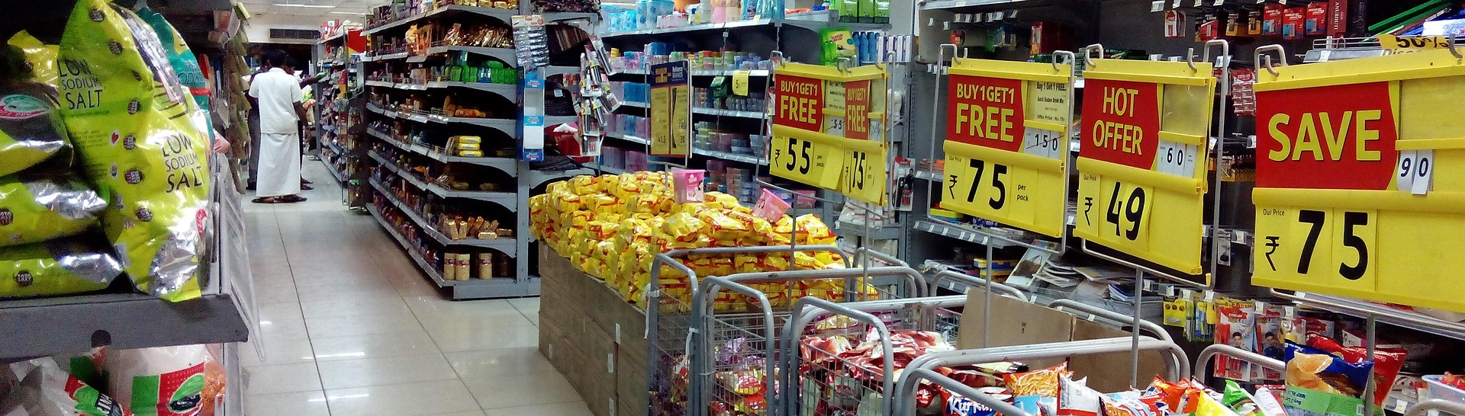
Demand forecasting use case
Group 2 – Jaron Lins, Julius Keune, Leonard Hegemann, Yaro Dusel
Notes:
Hello and welcome to our presentation of our results after this challenging month.
First of all, we want to thank you the inventory management agency for choosing us four to analyze this historical data.
We came to great results this last months that we want to share with you now, at the end we also have a little extra surprise for you.
But lets just start with our process.

Slide 3





Structure
EXPLORING
CLEANING AND TRANSFORMING
CLUSTERING
DECISION MODELS
REFLEXION & KEY LEARNINGS
Notes:
This will be the guide for this presentation but without further a do lets start with the first point of the argenda, be prepared to take a little walk trough the last months with your data.

Slide 4
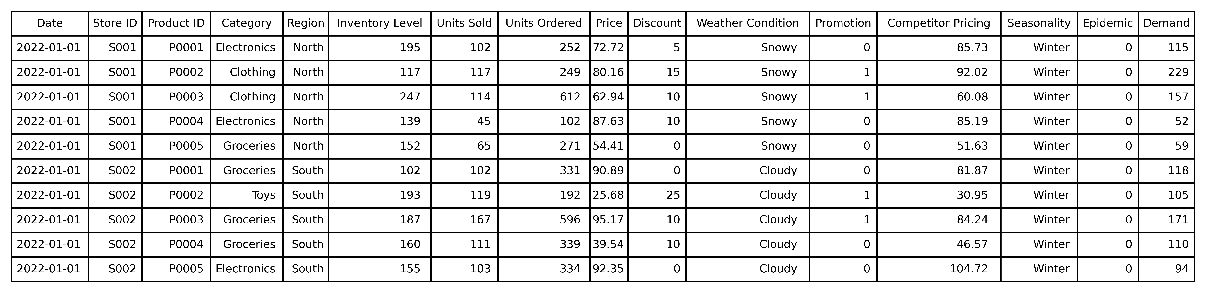
Exploring the data I
Notes:
Lets start by looking together on the data you gave us first.
As highlighted you data consists of data, from 18 days and 5 different stores with each 20 products of a timeseries. Not as much as we hoped but we made it work anyways.
Secondly you may notice that your ProductID is different for each product in different stores this means we have our first Challange

Slide 5
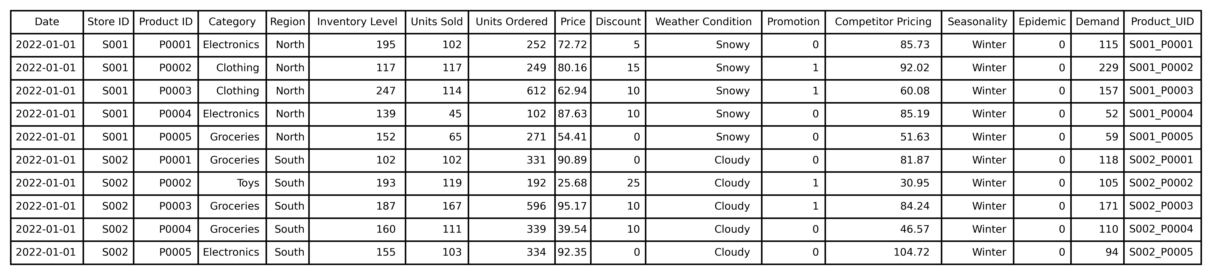
Challenge: Building A Unique Identifier
Notes:
In order to process the data we have to have a unique identifier for each product so we can be sure we are looking at the promotion over time of one unique product, this means for us building a unique identifier. By putting together the StoreID with the ProductID we get exactly this, not lets have a better look at our data and find the first patters by just looking at the different products and promotion.

Slide 6
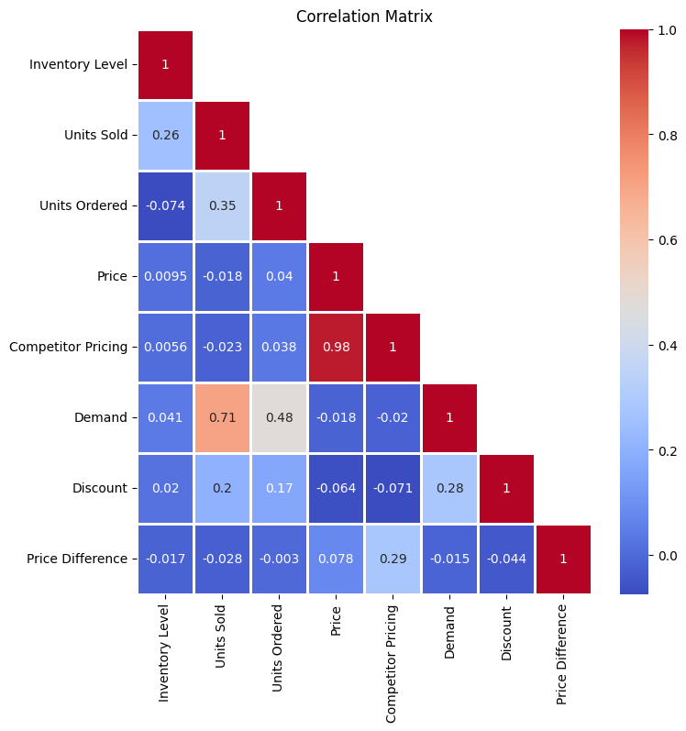

Exploring the data II
Pay attention to:
“Price” and “Competitor Pricing”
“Demand” and “Units Sold”
“Units Ordered” and “Demand”
Notes:
This figure on the right might look very scary but its simple, each numerical variable is on the x and y axis having a look for price and competitor pricing we see a red square with a number of 0.98 this means these two variables are almost equal, if you set a price of 20 cent, your competitor is almost every time doing the exact same price of 20 cent.
If you now have a look on high values we can notice that’s also the case for Demand and Units Sold which means your Demand forecast is pretty accurate and the same for units Ordered and the Demand, makes sense right? If you sell almost as any units as forecasted you are almost ordering the same, but not nearly the same as Price and Competitor price as a reference.
Lets go even further

Slide 7
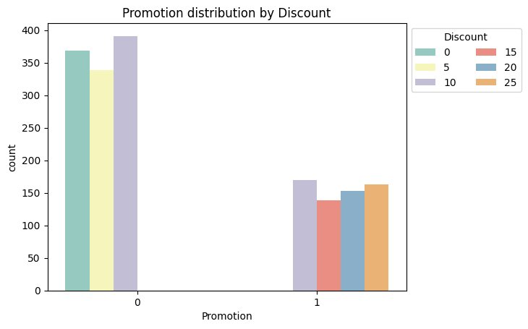
Exploring the data III
Promotion is determined by Discount:
<= 10
>= 10
No Promotion
Promotion
Notes:
Looking at the variable promotion together with the discount, we can see in this graphic on the right it is almost certainly you will promote a product which has a discount of 15, 20 or 25. Other than everything below 10 percent. Looking here some of the product with a 10 percent discount are also promoted, thats our first big knowledge extraction for our end result… or is it. Well we will find out later.

Slide 8
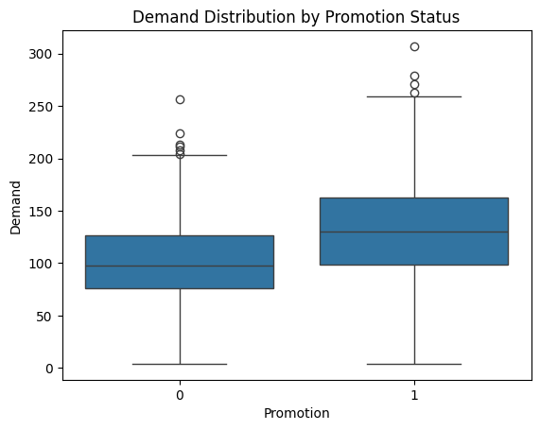
Exploring the data iV
Pay attention to:
The difference in mean
Thus, the influence of demand
Notes:
First of all, lets dig deeper, here we can see the promotion paired with the Demand. If you are not promoting a product this demand average is 100 as seen with this line, of because there are exception like the 250 demand even tough you didn’t promote anything, well looking at the right side it seems like the average of promoted product also have some kind of higher average.

Slide 9
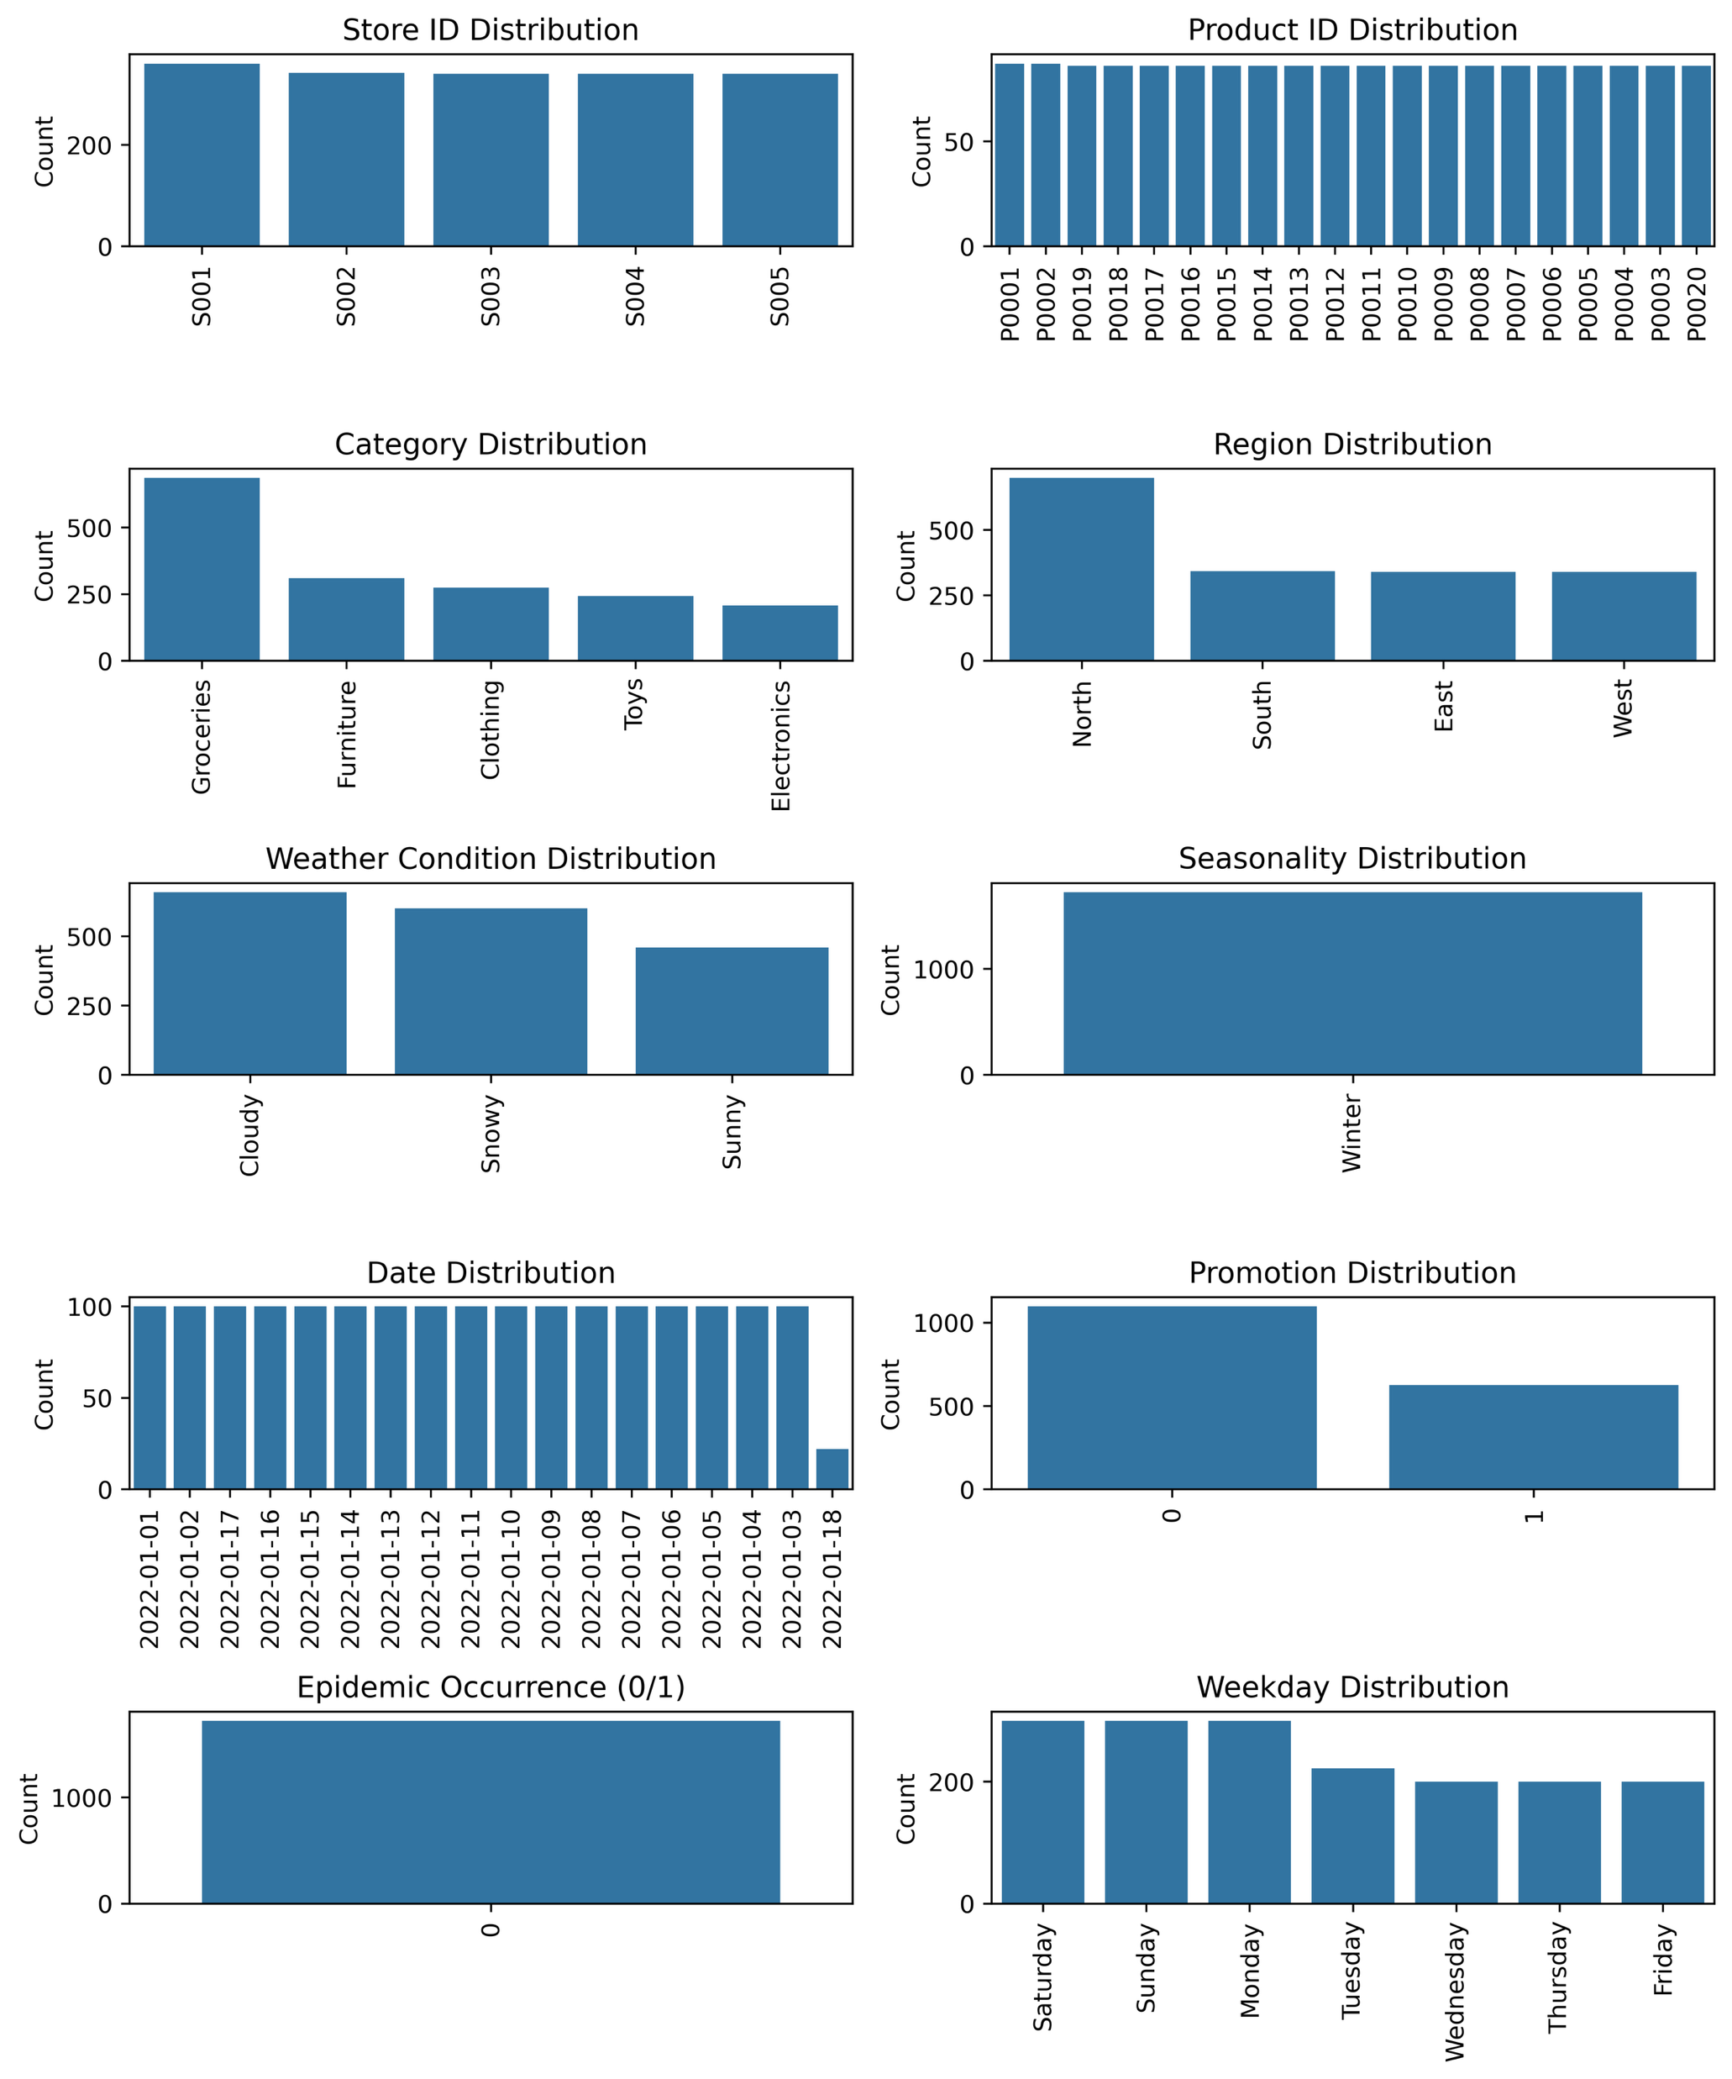
Exploring the Data V
18.01.2022 is not fully observed
Most Products are “Groceries”
Notes:
Some other interesting plots are for example the dates, as you see in this graph, we have 100 observations each day except of the last day. In on this day there are only observations from the store S0001 and two of store S002. Other than that there is not much special things about it Quite funny to see is that you almost only have products of the category groceries in your stores.
Now we really have looked enough on the data lets clean it to get the best results for our forecast.
Take it away Yaro…

Slide 10
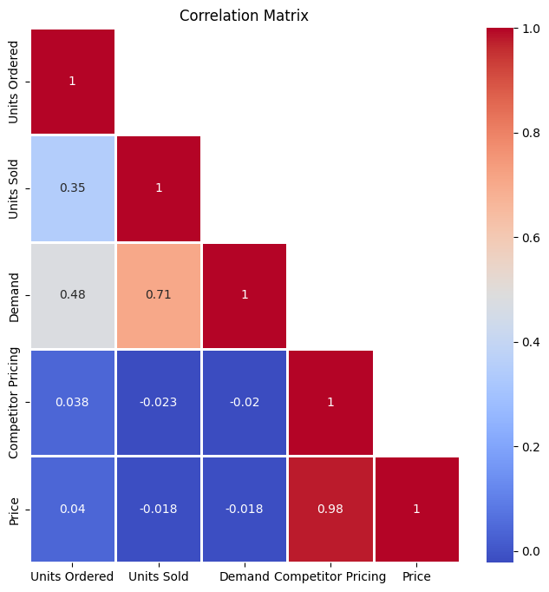
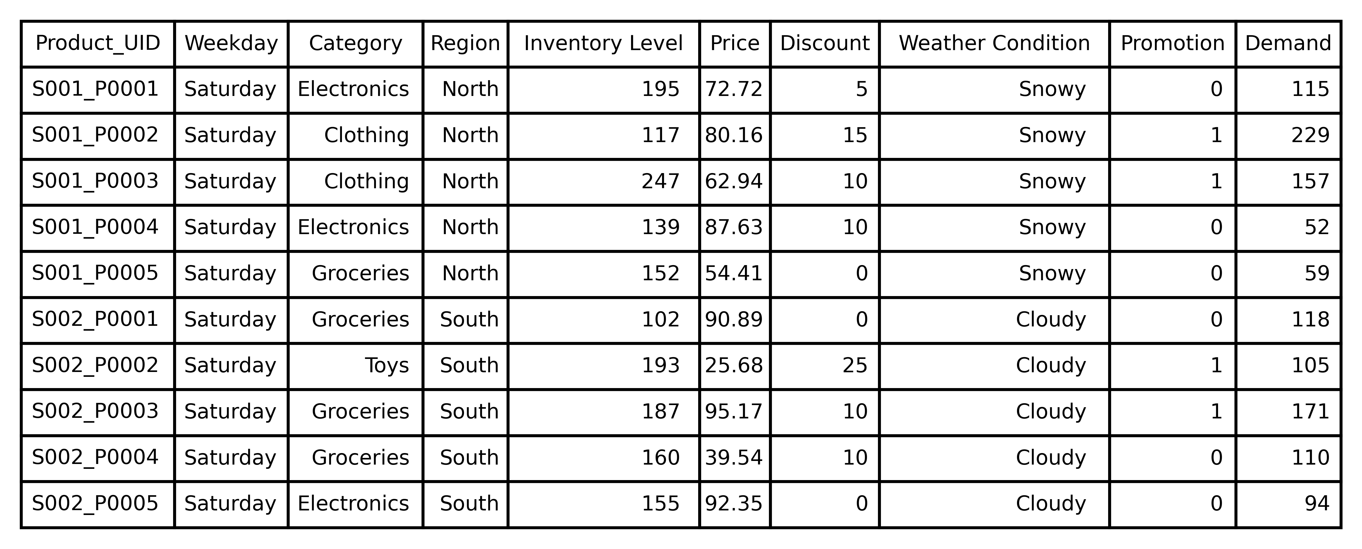
Cleaning the data I
We dropped “Epidemic”, “Seasonality”, “StoreID” , “ProductID”, “Date”, ”Competitor Price”, “Units Ordered” and ‘Units Sold”
We added the variable “Weekday” based on the Date
Notes:
To ensure reliable and interpretable results, we first cleaned your dataset by removing irrelevant or redundant variables.
Specifically, we dropped Epidemic and Seasonality because they only contained a single value throughout the dataset and therefore providing no additional information. Additionally like Julius said, Store ID and Product ID were combined into a unique identifier - so we could safely drop them individually. We also dropped Competitor Pricing, which showed very high correlation with your internal pricing, but added no predictive power.
The same applies to Units Ordered, which is closely related to Demand.
In the end Leo is going to explain to you why we removed the variable units sold and Date and instead added the variable Weekday
Now we have not only simplified the model, but also minimized redundancy between variables.

Slide 11
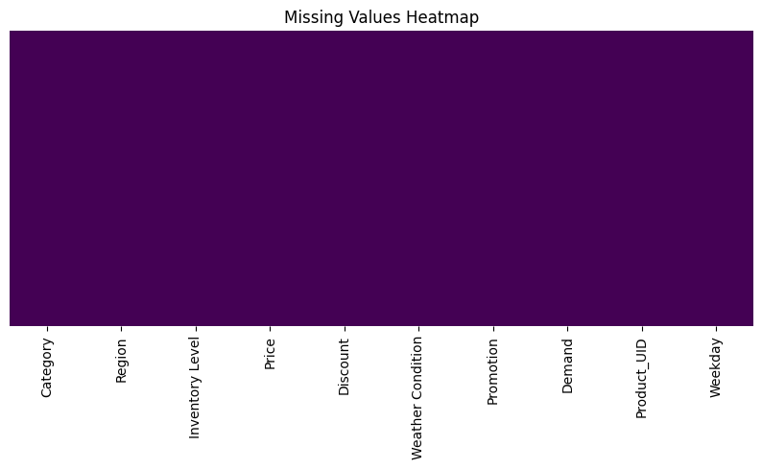
Cleaning the data II
Notes:
In the second part of our data cleaning,
we checked the dataset for missing values, nulls, or inconsistent entries - and found that no data correction was necessary.

Slide 12
Data Transformation
Feature | Value | Encoded as
Category | Clothing | 0
 | Electronics | 1
 | Furniture | 2
 | Groceries | 3
 | Toys | 4
Weekday | Friday | 0
 | Monday | 1
 | Saturday | 2
 | Sunday | 3
 | Thursday | 4
 | Thursday | 5
 | Wednesday | 6
Feature | Value | Encoded as
Region | East | 0
 | North | 1
 | South | 2
 | West | 3
Weather Condition | Cloudy | 0
 | Snowy | 1
 | Sunny | 2
Notes:
After cleaning, we transformed all categorical variables into numerical values using a Label Encoder.
For instance, Region was mapped from East to West as O to 3, This step was essential to prepare the data for clustering, since clustering algorithms like Means cant process string values directly.

Slide 13
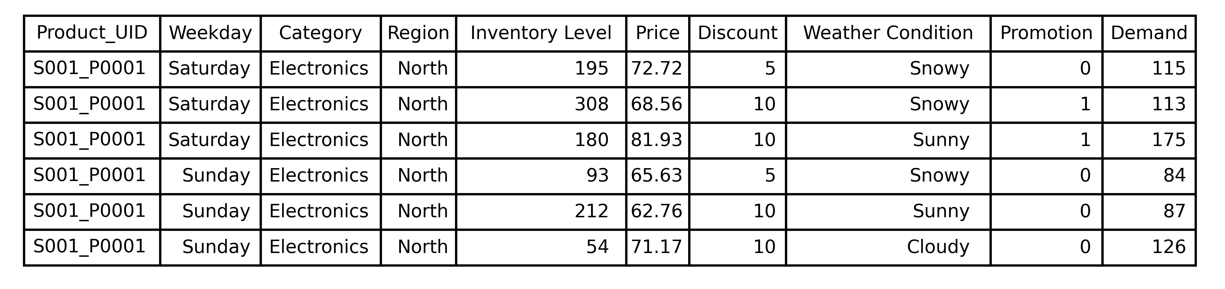
Challenge: Many observations and Different units
For visualization purposes, we excluded the transformation
Notes:
Since each product appeared multiple times in the dataset, the challenge was to combine those observations into a single, meaningful representation per product.
So we aggregated all records by product, using the mean of key numeric features like price, inventory level, discount, or demand. This step enabled us to perform product-level clustering, rather than clustering daily records.
Before applying clustering, we also scaled the numeric features using a StandardScaler as it in our case produced better results than Min-Max scaling.
The scaling is important to ensure that the clustering process was not biased by different units or scales

Slide 14
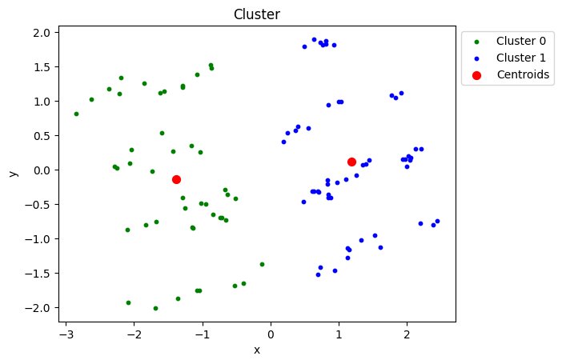
Clustering the data I
Key Points:
Data can be divided in two groups
Every data point stands for a unique product in a store
Notes:
In the next step, we used clustering to explore your product landscape.
each observation represents a unique product-store combination
The goal here was to understand whether products could be grouped based on shared patterns.
The result: your products clearly fall into two main clusters

Slide 15
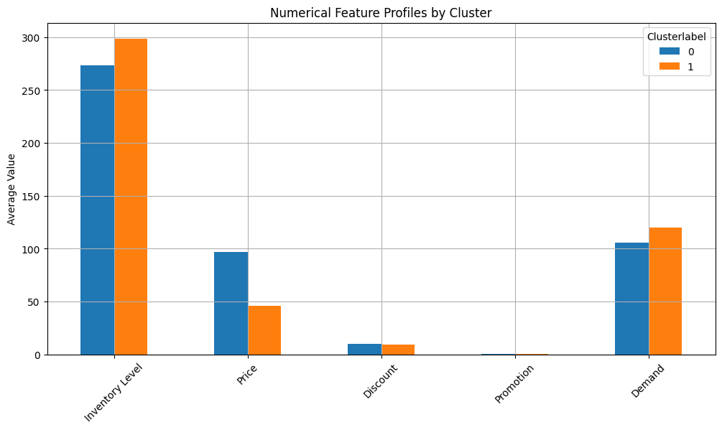
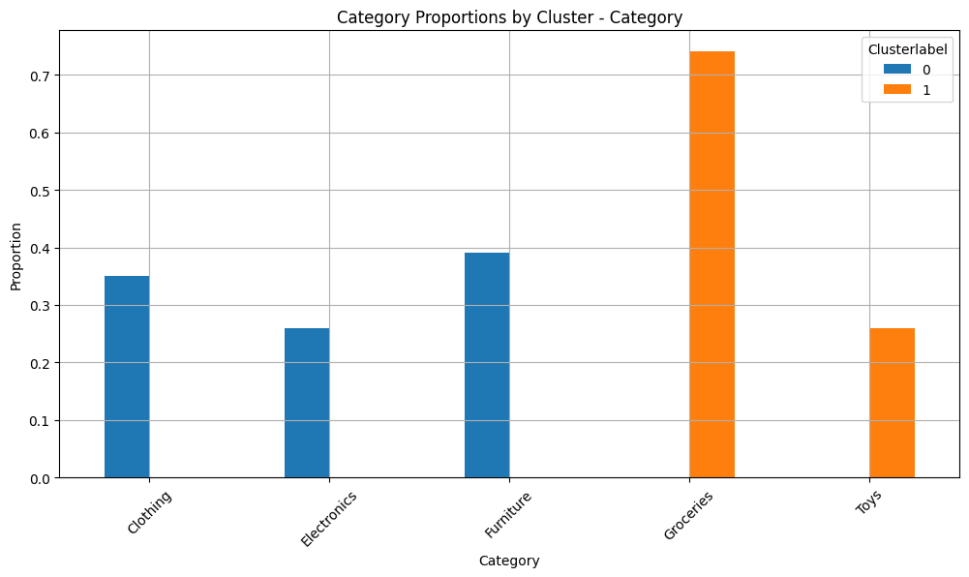
Clustering the data II
Key Points:
Clusters differ in price
Clusters differ in Product Category
Non-Fast-Moving Goods
Fast-Moving Goods
Notes:
As you can see, these clusters differ significantly in terms of price and category.
One cluster represents fast-moving consumer goods - typically cheaper and with high demand,
the secund cluster contains non-fast-moving products - usually higher priced, with slower turnover.
Now jaron will tell you about the next challenge we had

Slide 16
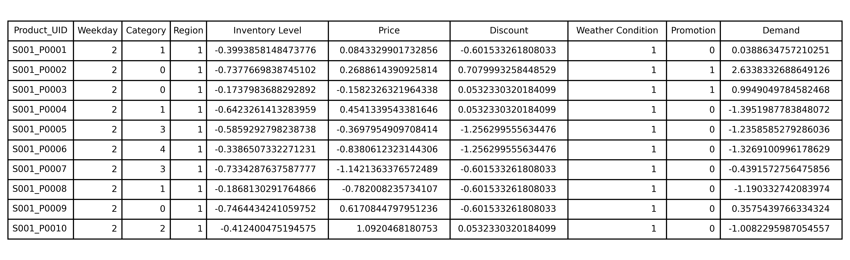
Challenge: Train on an interpretable dataset
Notes:
Now we’re reaching the most interpretable AI model the decision tree
This came with some challenges
The dataset contains scaled values (needed for KMeans clustering)
However, the decision tree cannot interpret scaled data correctly
Example: a price of -0.158 doesn’t make sense
Solution: we saved two versions of the dataset
One with scaled values (for clustering)
One unscaled version (for the decision tree)

Slide 17
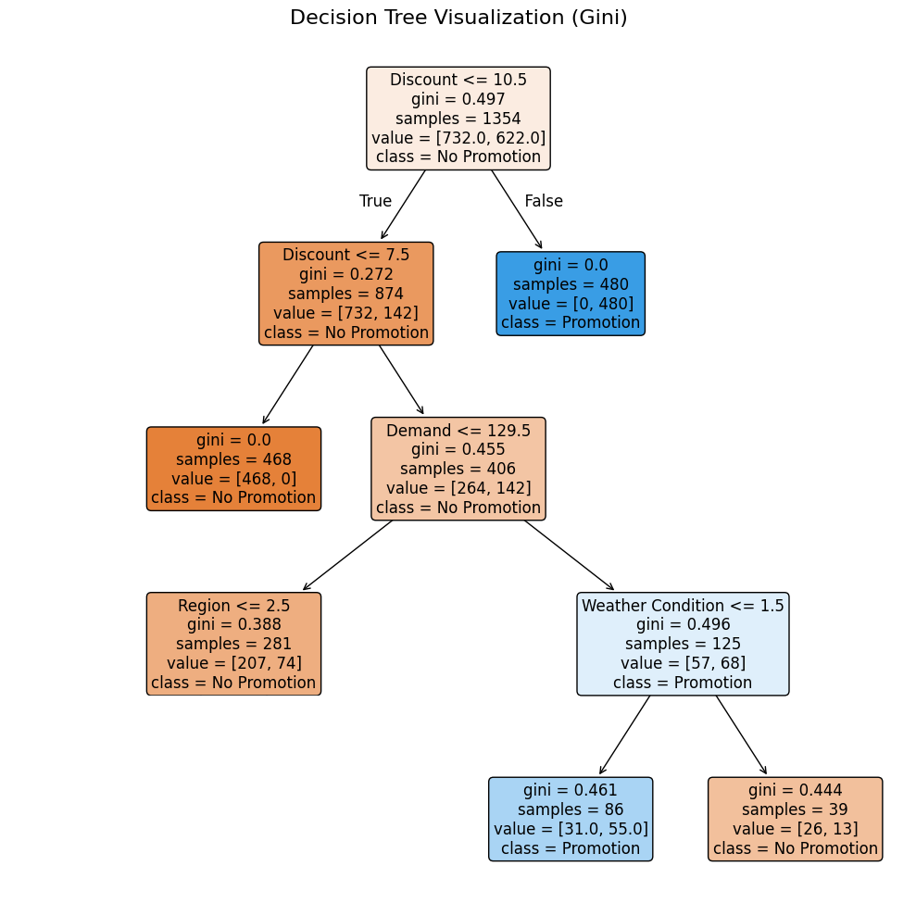
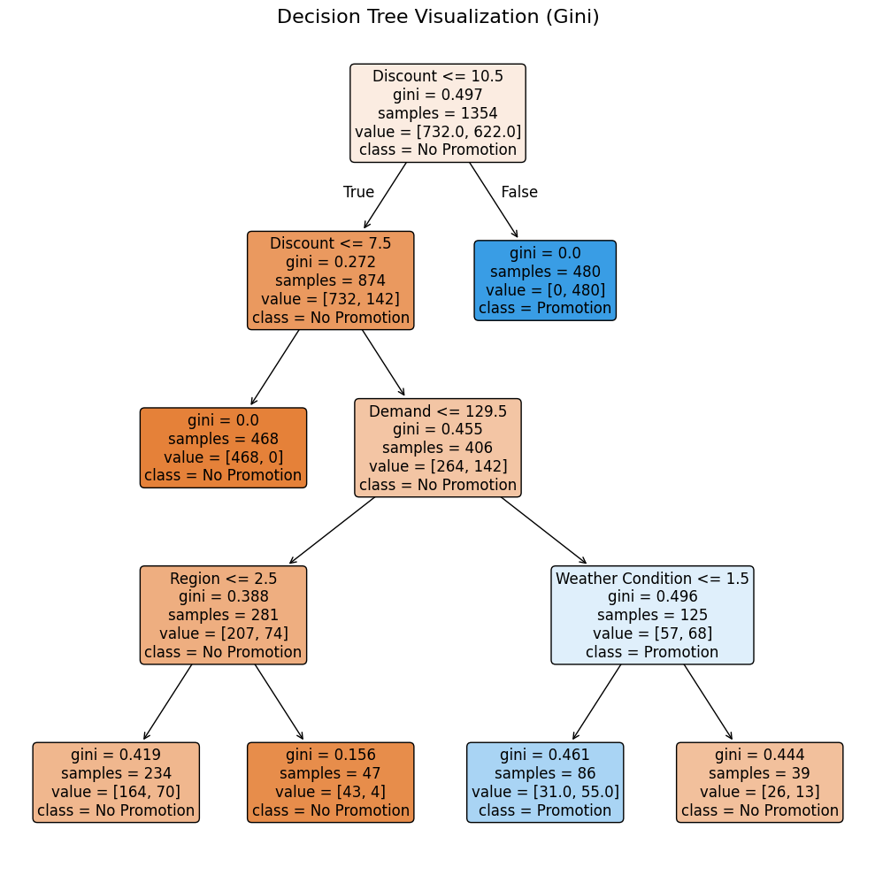
decision Tree I
Characteristics:
Gini Criteria
Augmentation with SMOTE
Split Validation but still robust!
Feature | Value | Encoded as
Weather Condition | Cloudy | 0
 | Snowy | 1
 | Sunny | 2
Discount
<= 10.5
True
False
Discount
<= 7.5
Promotion
Units Sold <= 144.5
No Promotion
No Promotion
Promotion
Notes:
We tried diffrent methods of decissiontrees but the best performing model was with the augmentation with SMOT
SMOTE is a technique used to balance imbalanced datasets by creating synthetic samples for the minority class.
For testing we used the Splitvalidation with the gini criteria
I don't want to bore you with technical details lets get to your decision tree

Slide 18
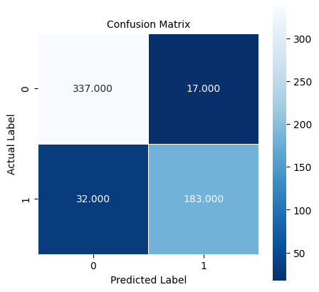
decision Tree II
Measures:
Real 1
Real 0
Accuracy = 91.31%
Predicted 1
Precision for class 1 = 91.50%
Recall for class 1 = 85.12%
Predicted 0
Notes:
But how reliable is this decision tree? There are diffrent methods to measure that.
Accuracy (Correct predictions) / (Total predictions) = (TP + TN) / (TP + FP + FN + TN) How many of the predicted values are predicted correctly?
Precision (Correctly positive predicted) / (Positive Predicted)= TP / (TP + FP) How many of the positive predicted values were actually positive?
Recall (Correctly positive predicted) / (Real positives) = TP / (TP + FN) How many of the real positive values have we predicted positive?

Slide 19
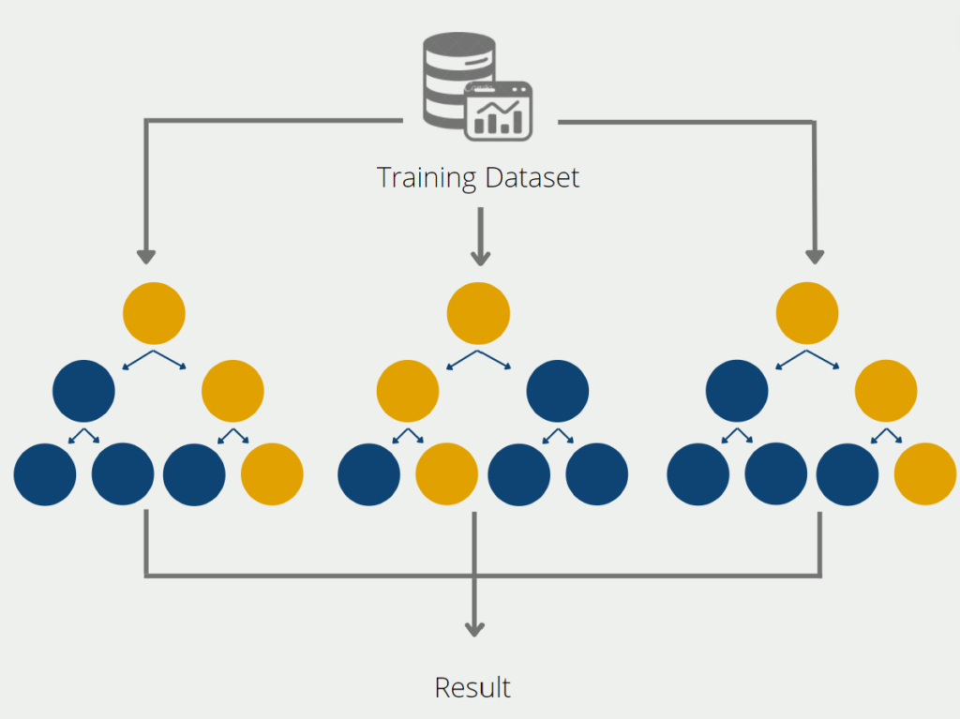
Decision Models – Random Forest
Measures:
Accuracy = 90.68%
Precision for class 1 = 96.55%
Recall for class 1 = 78.14%
https://databasecamp.de/ki/random-forest
Notes:
A Random Forest is an ensemble machine learning model that combines many decision trees using random subsets of data and features to improve accuracy and reduce overfitting.

Slide 20
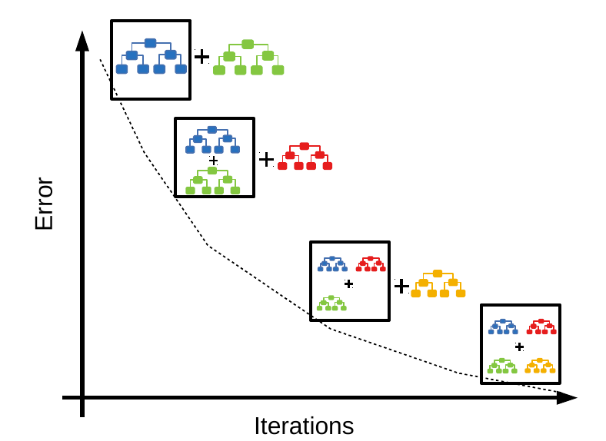
Decision Models – XGBoost
Measures:
Accuracy = 90.51%
Precision for class 1 = 92.59%
Recall for class 1 = 81.39%
https://neptune.ai/blog/xgboost-vs-lightgbm
Notes:
XGBoost works by building decision trees one after another in an iterative way, where each new tree focuses on correcting the prediction errors of the previous trees which minimize error function

Slide 21


Pros and cons
Handles non-linear relationships
Performance vs. Interpretability
Cost efficient to compute
Small Data Sample
Very good predictions
No online updates possible
Interpretable
Sensitive to small changes in data
Notes:
Okay, so now let's talk about some pros and cons of our approach. The first thing I want to mention is that we could easily build a more performant model, but only at the cost of loosing the interpretability as the tree would grow huge and you could not extract useful information from it. Secondly, our model is trained on a small data sample which works perfectly fine. But in general, the predictions can be improved with more observations (Law of large numbers). So, if you have gathered more in the future, lets meet again. Further, our model lacks online updates. This means we can not update the model „on the fly“ with single data points, but we need to gather the new data and retrain the whole model at once. Lastly, the decision tree is sensitive to small changes in the data. As every split that you have seen depends on the root node, changes in here will alter the whole tree.
Despite the disadvantiges we also have some strong benefits. With the decision tree we have a flexible model that can handle different types of nonlinear relationships. A big win for you is, that it is very cost efficient to compute, both for training and predicting. As Jaron has shown before, we have derived very good prediction with interpretable rules which give you great insights into the promotion forecasts.

Slide 22
Lessons Learned
Be careful with Time Series Data
Data Leakage as essential problem
Combine ML Models to gain further insights (KMeans + Decision Tree)
Notes:
Let’s now take a look at some important learnings that we made. Time Series Data like you gave us are highly interesting. However, they bare some challenges. We learnt that rather using the specific date data that you provided us, we can extract repeating weekdays from it giving our model even more knowledge to train on and find patterns in.
A second big learning is the handling of data leakage. We don’t want to give our model data that wouldn’t be available at runtime. To predict, whether a product should be promoted in the morning or not can’t be decided based on the sold units of the day. These numbers are not available until the end of the day and will be affected by the promotion decision, which is why we should use the forecasted demand instead.
Lastly, we have learned that combining different ML Models can be useful. In your case, we took the cluster labels and thought okay well, how can we explain them? We merged the labels back into our original dataset and threw it into a decision tree with the task: Predict the labels and got the exact identical findings

Slide 23
Key learnings: Added value
Label your products uniquely over all stores
Consider restocking more sustainable – or potential theft?!
Take your discount as key indicator for promotion
If no clear recommendation, take demand and weather into account
Notes:
But now enough from our side, towards the end we want to summarize the key learning for you. First, you should consider to label your products uniquely over all stores as it would simplify further analysis.
Secondly, we found out that the you restock way more than you have actually sold in these 20 days. To reduce your storage costs, you can think about restocking your products in a more sustainable way. Restocking more without selling more can also be related the potential theft, . If you want us to do some further analysis, feel free to reach out.
And lastly, regarding the task of predicting the promotion you should focus on two things regardless of the specific product. First, you should take your discount as key indicator. If this does not give you a clear recommendation, you should take the demand and the weather into account.

Slide 24
Thank you for your attention!
Group 2 – Jaron Lins, Julius Keune, Leonard Hegemann, Yaro Dusel
Notes:
Okay, we know this has been a lot of information for you. If you have any questions right now, please don‘t hesitate to ask. For you to further discuss our findings, we have summarized them on a little handout. If you come up with some questions after today, feel free to write us an E-Mail. You will find our E-Mail addresses below on the handout. For now, thank you for your attention.

Slide 26
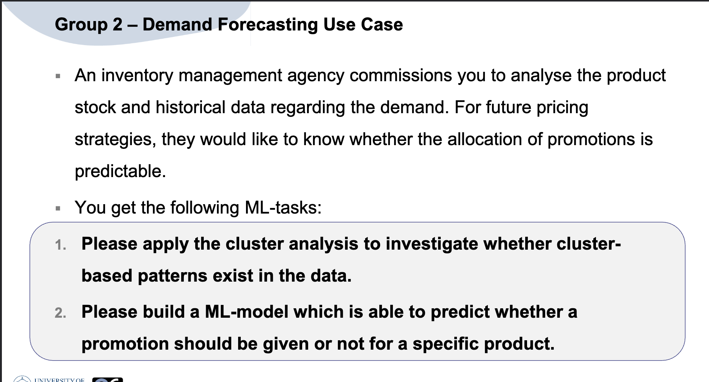

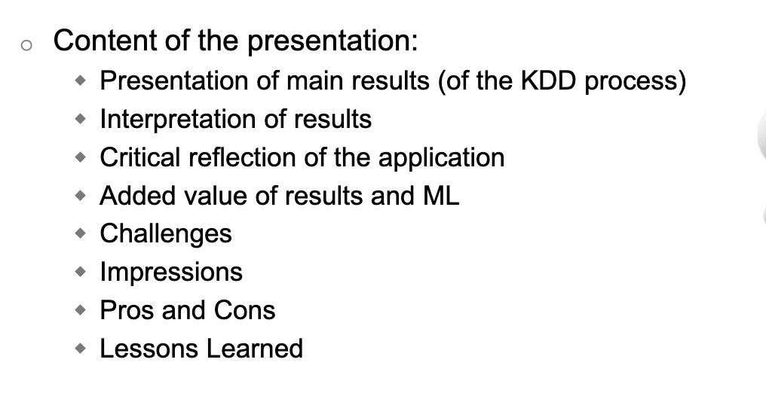
Demand Forecasting Use Case – Final Presentation
Group 2 – Leo, Yaro, Julius, Jaron

